Slide 1
Year 7 Transfer Evening 2024 (This PowerPoint is on our website, in the Year 7 transition area)
Notes:
GWH

Slide 2
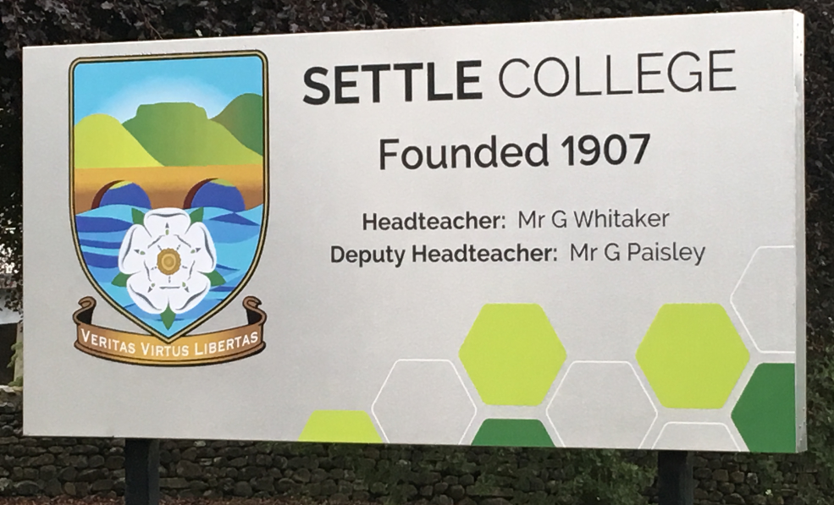
A warm welcome to Settle College
You are part of the family
Notes:
GWH

Slide 3
Programme for tonight
Welcome and meet the team.
Year 7 students to meet their Form Tutors / Parent information.
Year 7 students back to the hall
Opportunity to meet Learning Manager, Senco, Head of Year, Uniform Suppliers and Finance Team
Notes:
GWH

Slide 4
Staff
Mr Whitaker –Headteacher
Mr Paisley - Deputy Head Teacher
Mrs Grimshaw –Special Educational Needs Coordinator
Head of Year – Mrs Lambert
Learning Manager – Mrs Ashton-Fitch
Tutors – Mrs Craig, Mr Wiggans, Mrs Hawkins and Ms Armistead
Notes:
GWH

Slide 5
‘be the best you can be’ ‘striving for excellence in everything we do’
Notes:
GWH

Slide 6
Time to meet your tutor
Notes:
NJO

Slide 7
What is happening tomorrow during transfer day
Form time – meet in the hall
P1 – lessons
P2 – lessons
Break
P3 – lessons
Lunch
P4 and P5 – Trailblazers and lessons
Notes:
GPA to the end

Slide 8
A Partnership With Parents/Carers
Your child will get the best from their education if:
Parents and teachers work together.
We let you know quickly if there are problems in school.
You let us know quickly of problems which may affect your child e.g. bereavement, family break up etc.
We support each other.
Notes:
GPA

Slide 9
How Parents Can Help
Ensure good attendance.
Provide a quiet space for homework to be completed.
Encourage your son/daughter to get involved.
Contact us if there are problems via tutors or the Heads of Years email.
No leave of absence in term time unless ‘very exceptional circumstances’.
Notes:
GWH

Slide 10
Putting Learning into Context
Approximately 25% of companies have implemented AI to tackle labour shortages.
We need to teach them the skills of adaptability, resourcefulness, resilience… and certainly following the pandemic students, families and schools have had to work differently. We are here to support and have the students at the heart of all we do.
Literacy is key.
Notes:
GWH

Slide 11
Subjects & Home Learning
Bring correct books and equipment for each day.
Home Learning – no more than 3 subjects per night, we do not have a set timetable – 30 minutes each but at times more.
Planners are now no longer used, we use our management information system, Arbor, for all homework to be recorded electronically, parent/carers shall have a login to this, showcasing all Home Learning, positive and negative behaviours.
Logins shall be provided in the first week of term – September 2024.
Notes:
GWH

Slide 12
Cashless Catering
In September students will need to use the Cashless Catering System.
Students will use biometrics for cashless catering
Student accounts can be topped up:
Online using Parent Pay – you will receive a log-in.

Slide 13
Lunchtime
School lunch or packed lunch.
Going home for lunch with a letter and pass.
Students are not permitted to go into Settle or Giggleswick at lunchtime through years 7 - 11.
Notes:
GWH

Slide 14
WELCOME TO SETTLE COLLEGE DINING ROOM!
On transfer day, Year 6 can either pay with cash, or we can record what they’ve had and add it to their ParentPay account in September
Please pick up a price list to see how much things cost. Food can be bought at breakfast, break-time and lunch-time so it’s a good idea to discuss with your child how much they are allowed to spend!
An idea of what we serve: Morning break: Hot snacks (pizza, toasties, bagels), cold sandwiches, homemade traybakes Lunch: Grab & Go: Sandwiches, Wraps, Cold Pasta boxes, warm paninis. Home-made traybakes, Fresh Fruit, Yogurt, Jelly. Eat in: Hot dinner (1 or 2 courses) which will be…

Slide 15
DINING ROOM – What will be served on transfer day?
Tomorrow’s hot meal is:
Roast Gammon with a Yorkshire Pudding OR Vegetable Lasagne Optional vegetables: Roast Potatoes, Cabbage, Leeks in cheesy sauce)
Hot pudding: Sticky Toffee Pudding with Ice Cream
Or choose a jacket potato
Or choose a sandwich, wrap, panini etc and a home-made traybake
You can pick whatever you want, you don’t have to have the things you don’t like!
You don’t have to be vegetarian to choose the vegetarian meal
Hot food is served on crockery so must be eaten in the Dining Room. For anything else you can eat in the dining room or take food outside – but DON’T EAT ON THE CORRIDORS!!!

Slide 16
DINING ROOM – Choosing your meal, and accessing clubs
Our 2-course hot “meal deal” ( main course, carbs, 2 veg and a pudding) offers best value and nutrition at £3.30
We sell jacket potatoes every day with all the favourite fillings (cheese, tuna mayo, baked beans etc.)
Every Wednesday is roast dinner day, with homemade “roasties” and roasted fresh vegetables.
Every Friday is “chip day” – choose fish, chicken or veggie burgers, or just cheesy chips!
Year 7 come to the Dining Room earlier than everyone else to avoid the rush.
If you join a club, you get a pass to enable you to jump the queue so you can get to your club quickly

Slide 17
Attendance
Our attendance target is 96%.
If attendance falls the Attendance Officer Mrs Isherwood shall be in contact with home.
Notes:
GWH

Slide 18
Holidays in Term Time
Classed as unauthorised absence.
We can grant leave of absence in very exceptional circumstances but this would need to be discussed with the Headteacher.

Slide 19
Trips & Visits
Currently in our Calendar:
Year 7 Chester Zoo – Autumn 2024
School Music Production Summer 2025
School Ski Trip - Years 8-9 Easter 2025
Years 9 – 11 - Battlefields Trip July 2025 – Annual Trip
Rewards trip - July 2025
Several Careers opportunities
Notes:
GWH

Slide 20
Financial Assistance
Available from the Jenny Walker Fund by application, available to those families entitled to financial support.
Notes:
GWH

Slide 21
Challenge stars–
Your son/daughter will receive a challenge card once per term.
Your son/daughter should ensure they challenge their learning during the school day, teachers nominate a student per lesson for their personal challenge within a lesson.
This has been introduced in order to ensure students challenge themselves to be their best.
Once filled out in a term students as a group decide upon their reward. Previous rewards have been Christmas dinner, an Easter egg hunt for an afternoon.
Notes:
GPA

Slide 22
Primary Information
Primary schools have shared key information through 6 into 7, as well as meetings between staff within all schools.
Year 6 Teacher Visits
Year 6 Teachers observe core subject lessons to ensure no regression from Year 6. This is scheduled for the new academic year.
Notes:
GPA

Slide 23
How will I know how well my child is doing ?
Students will receive 3 Progress Reviews in Year 7.
Each Progress Review reports on your child’s expected end of Key stage 3 performance in each subject. We also include an Attitude to Learning score which reflects the effort applied in each subject.
Year 7’s have a meet the tutor evening in the first half term and a formal parents evening in the first half of the summer term.
Arbor will give you instance access to an overview of academic and attitude success.
Notes:
GPA

Slide 24
Arbor is the new home learning planner
Students will have access to their account. This can be done on a computer/tablet or phone.
Notes:
GPA

Slide 25
Who To Talk To
Day to day problems – Form Tutor (first point of call)
More serious issues, health matters – Heads of Years
Academic problems – Class Teacher or Head of Department
Special Needs – Mrs Grimshaw
Please phone first – the person you need to see may not be available
Notes:
GPA

Slide 26
Uniform
Uniform important (jumper optional, blazer is compulsory)
Available to view in the lobby area
Key areas of concern:
Hair – please no obvious dying
Jewellery – a watch and a single pair of plain gold or silver studs
Make up – please don’t wear
Skirts or Trousers must be tailored – no leggings or skin tight trousers.
Trainers – only for P.E
Black shoes - unmarked, not suede/canvas/board shoes or boots
Mobile phones & i-pods – switched off and in bags
Notes:
GPA

Slide 27
PE - Uniform
Physical Education Kit – All Students
•Navy and White polo shirt with College logo
•Navy & White reversible rugby shirt with college logo (girls and boys)
•Navy & White shorts/skort
•Swimwear for Year 7 only
•Navy & White games socks (Compulsory for Rugby/Hockey and Football)
•White trainer/ankle socks (can be used for any activity other than above)
•Rugby Warm-up top- optional (hoodies are not permitted for Rugby/ Netball)
•Navy & White hoodie with College logo – optional (no other hoodies permitted)
•Shin pads (compulsory for football and hockey)
•Gumshield (recommended)
•Layers worn underneath MUST be black/navy blue (leggings may be worn AS WELL as the College skort)
•Footwear depends on the sport for the term: rugby/football boots, (MUST be worn for rugby and football) non-marking trainers (no Converse or plimsoll style shoes).
•All students MUST change at the end of lessons and leave school in their full school uniform.
Notes:
GPA

Slide 28
PPG & PTA
The PTA needs your support – meet half termly to raise funds to spend on students such as on rewards.
First meeting for the new year is advertised in the Parent Information Pack.
Parent Partnership Group – Meet half termly - Do you wish to play an active role in decision making? Past topics of discussion have included curriculum models and Feedback on planners and reporting. Meeting tonight alongside transition.
Notes:
GPA

Slide 29
Lockers
Lockers can be rented for a fee of £35.00 for their time at Settle College. None refundable.
Lockers can be ordered and payments made on Transfer Evening by cash or cheque.
Locker keys will be issued on the first day of term. Lost keys charged at £5
Notes:
GPA

Slide 30
Music Lessons
Many students already take lessons.
Concerts, shows and plays.
Opportunity to continue.
Opportunity to begin an instrument.
Give your name to Head of Year this evening who shall pass on to our music teacher.
Notes:
GPA

Slide 31
E-Safety
Students do not need to bring a phone to school.
Facebook, snapchat, MSN etc
Students need to be aware that what they write on these sites is in the public domain.
Unpleasant comments can be seen as bullying outside of school.
Universities and employers are increasingly using searches as part of the recruitment process.
A growing problem, nationally and locally.
Students acknowledge our e-safety policy by signing on to use schools IT.
Notes:
GPA

Slide 32
Website & Twitter
www.settlecollege.org.uk
Follow us on X:
@settlecollege
Notes:
GWH

