Slide 1
Exams support evening

Slide 2
Miss Nutter – Learning and Revision
Subject Leaders of English, Maths and Science
Mr Murphy – Exam processes
Elizabeth and Helen
Senior Mental Health Practitioners (SMHP) Bradford and Craven Mental Health Support Team Trailblazer

Slide 3
Staff will stay at the end for any questions.
This PowerPoint will be added to the school website tomorrow.
There are no fire alarm drills; if the fire alarm does start, please follow staff to the tennis courts.

Slide 4
Supporting your child with revision
Planning a revision schedule
Providing the correct environment
Strategies to use to support revision
Specific strategies for English, maths and science
Information that will be provided to students and parents/carers

Slide 5
Supporting your child with revision
Guidance for making a revision schedule:
Find out the dates of the exams – how many days are there until the start of the exams?
Discuss with your child about how long they will focus on revision for in a single block without distractions – advice is for blocks of 20-30 minutes.
Work out how many 'sessions' of revision students will be able to do each day.
Think about how many sessions there are for each subject and assign those to the days in the schedule.
I wouldn't recommend assigning topics to a session yet.
This should be done on the day and should not be topics in which they are already confident. It is helpful to have a list of key topics for each subject that they want to focus upon during their revision.

Slide 6
Supporting your child with revision
Providing the correct environment:
Ensure that revision is completed at a table, where possible – the key thing is to have an area that is dedicated to revision
Avoid having background noise – including television and music
Remove access to technology for the block of time that they are revising – it should be accessed in breaks between revision sessions

Slide 7
Supporting your child with revision
Strategies to use to support revision:
There are two key areas to address in revision:
(1) Storing the information into your long term memory – this is supported by making connections to other pieces of information already in the long term memory, as it creates a filing system in the brain
(2) Retrieving the information back out of your long term memory
Many revision techniques address both of these.
The key is that revision needs to be active – the brain needs to be processing the information.

Slide 8
Supporting your child with revision
Strategies to use to support revision:
Flash cards
On one side, write a question or a skill to be described.
On the other side, write the answer or method used in different contexts using their exercise book, revision guides or websites.
Using them: either test themselves, find a family member/friend to test each other or answer a practice exam question and use the card to add to your answer/check it is correct.
Revisit regularly questions or topics that they aren’t getting correct as regularly.
Mind maps
These work in a very similar way, but do make the links between the different topics more explicit.

Slide 9
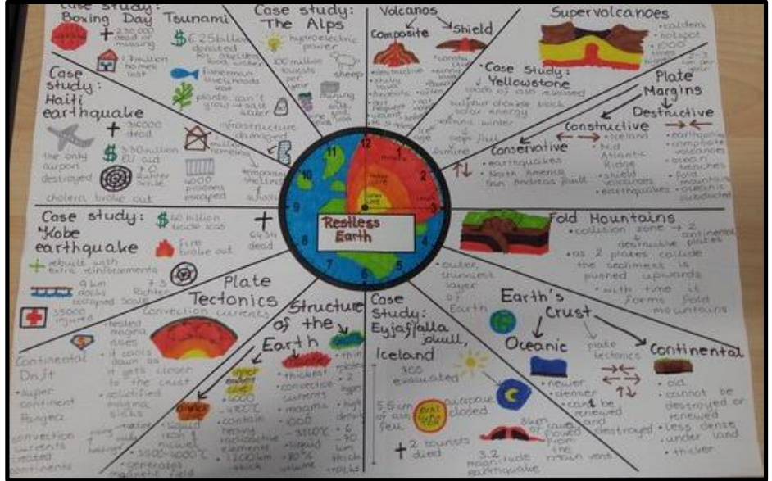
Supporting your child with revision
Strategies to use to support revision:
Revision clock
Write the topic title in the middle and then split the paper into 12 segments.
In each segment, write a different question or sub-topic.
Using one pen colour, spend a fixed amount of time writing the answer to a question or sub-topic in the segment, before using a different colour to add information to the answer using revision resources.
Repeat this for all of the different sections.
The information in the second colour are the areas to focus upon in later revision.
The clock exercise can then be repeated to see if they remember more each time, or they could challenge themselves by giving less time for each section.

Slide 10
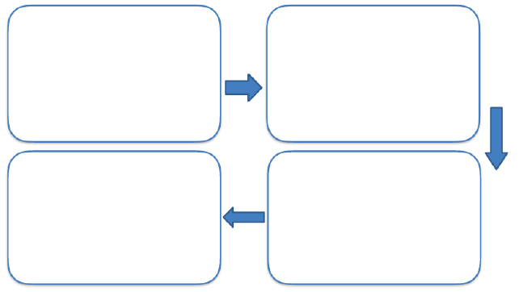
Supporting your child with revision
Strategies to use to support revision:
Retrieval relay race
Without using notes, they should write as much as they can remember in the first box.
Spend 3 minutes going over their notes again, before them away.
Add any further information that is remembered into the second box.
Repeat these steps for boxes three and four.
It should give a summary for the topic, and the information in later boxes highlights the parts in which they are least familiar.

Slide 11
Supporting your child with revision
Strategies to use to support revision:
Flashback Friday
During the week, create a series of 10 questions based on what they’ve revised that week for that subject, especially focusing on areas that they’d struggled to remember.
They should then answer the questions each Friday, but also look back to question lists from previous weeks to make sure that they can still answer those questions.

Slide 12
Supporting your child with revision
Strategies to use to support revision:
Past papers
Past papers should be completed to practice applying knowledge to exam questions, as well as getting familiar with the type of questions.
There are different approaches to using notes to support answering questions or doing it all from memory.

Slide 14
GCSE English language
Two equally weighted papers.
Paper 1: One fiction extract
Section A: Four questions [40 marks]
Section B: Creative writing [40 marks]
Paper 2: Two non-fiction extracts
Section A: Four questions (2 comparative) [40 marks]
Section B: Transactional writing task [40 marks]

Slide 15
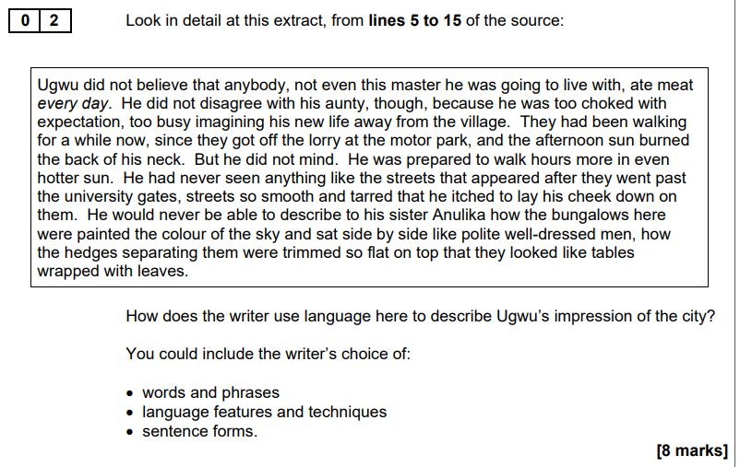
Know the question types and timings! Paper 1
5 minutes
Bullet point
Word connotations
Metaphors
Similes etc.
What? How? Why?
10 minutes

Slide 16
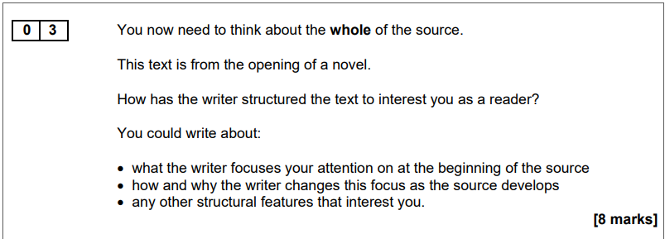
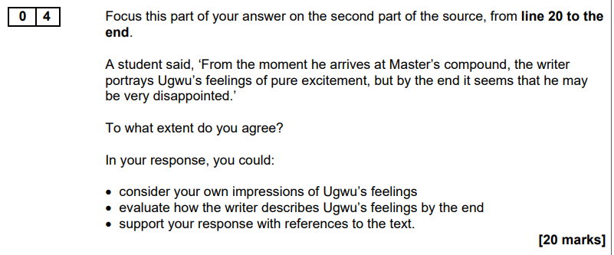
Narrative shifts/changes
Repetition
Cyclical structures
and effect
Evaluate.
Writer’s method: how are feelings conveyed?
10 minutes
25 minutes

Slide 17
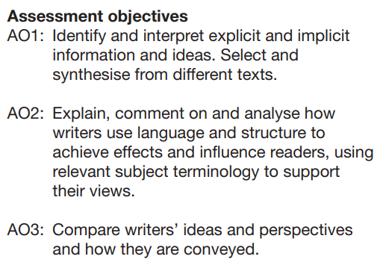
Know the skills being assessed!
Section A

Slide 18
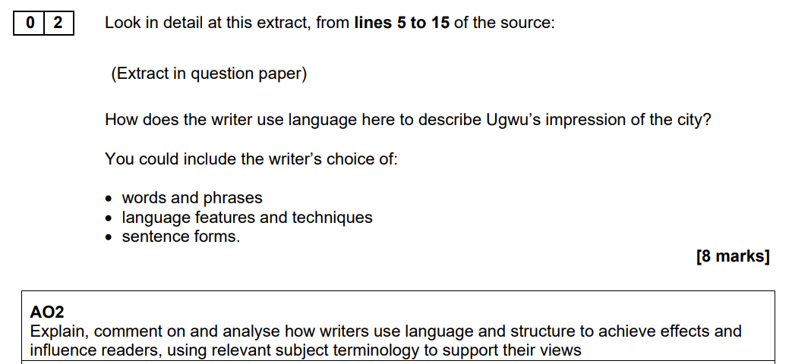
Paper 1 Question 2: How does the writer use language …
Paper 2: Question 3. How does the writer use language … ? [12 marks]

Slide 19
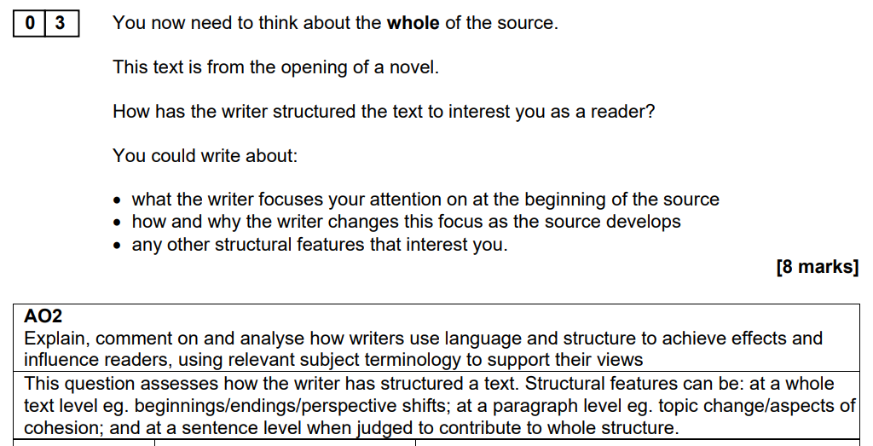

Slide 20
Paper 1, Section B

Slide 21
Paper 2, Section B

Slide 22
Knowledge organisers

Slide 24
Literature
The key texts

Slide 25
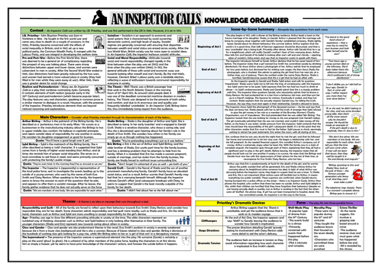
Knowledge organisers

Slide 26
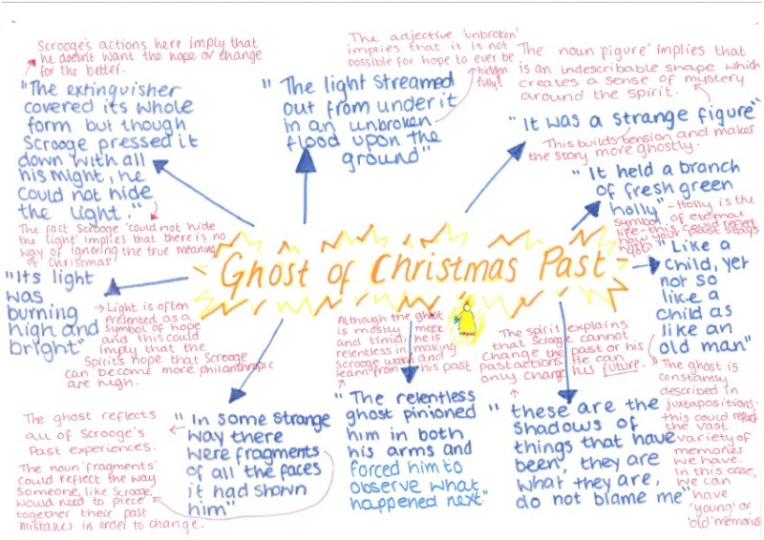
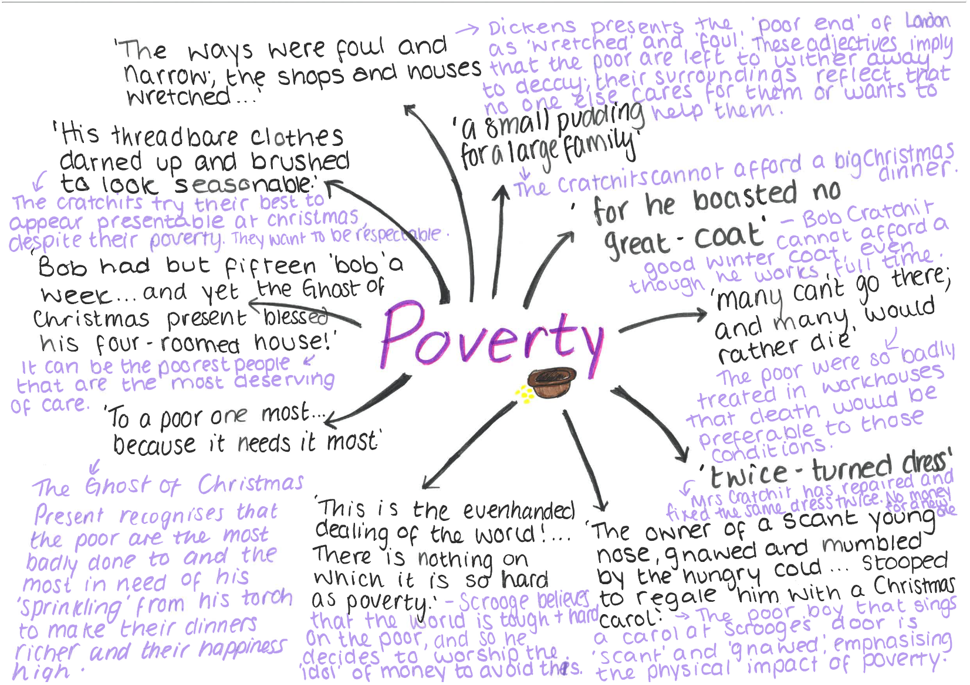
Revision guides/cards

Slide 27
Create your own!
Key word: Misanthropic
Misanthropic means …
to have a strong dislike and distrust of other people.

Slide 28
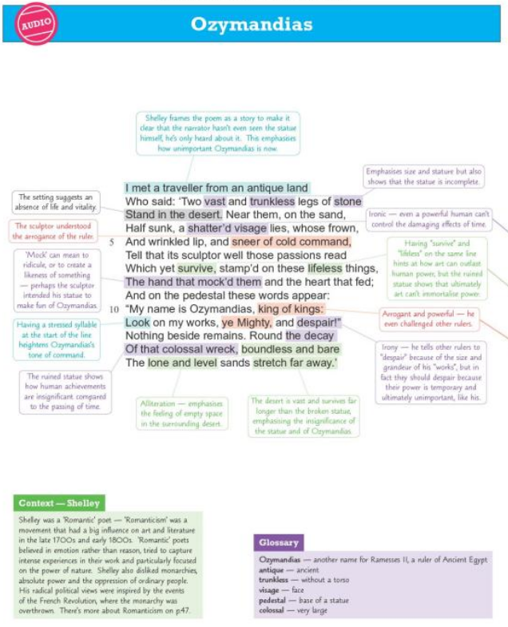
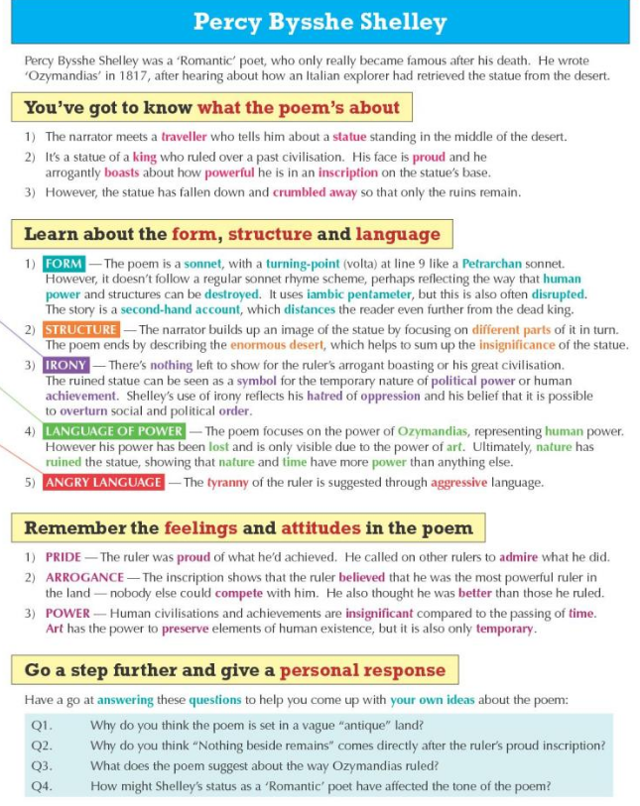
Chunk down:
Overview of the poem
Poet’s message / mood
Structure
3 key quotes /
devices/images and effect

Slide 29
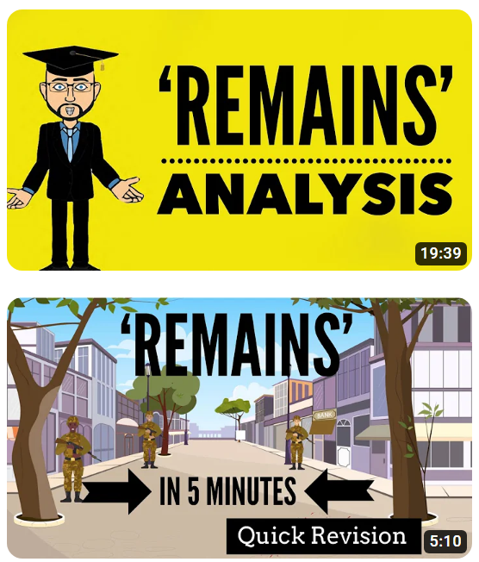
Online resources
Mr Bruff videos (Lit and Lang)
Mr Salles videos (Grades 7-9)
Mr Bruff videos (Lit and Lang)
Mr Salles videos (Grades 7-9)

Slide 30
For Language and Literature
aqa.org.uk
Past papers
Mark schemes
Examiner reports
Support materials

Slide 31
GCSE Maths
3 papers – all worth 100 marks
Paper 1 – Calculator
Paper 2 – Non-Calculator
Paper 3 – Calculator
Foundation will be graded from Grade 1 up to Grade 5
Higher will be graded from Grade 4 up to Grade 9
All Exam boards have the same Maths Content so you do not have to stick to one board

Slide 32
GCSE Maths – Top 5 tips
Tip 1: The best way to revise GCSE Maths is to DO Maths
Tip 2: Revise lots of different topics in rotation
Tip 3: Try some exam questions, fill in the gaps, then go back and try again
Tip 4: Understand the mark scheme
Tip 5: Don't overdo it!

Slide 33
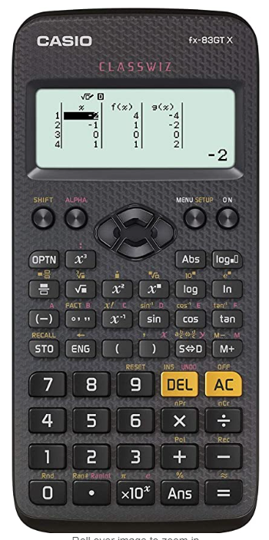
Calculators
76% of the questions are Calculator questions … It makes sense to have and know your calculator.
We recommend the Casio FX83 GTX or FX85 GTX

Slide 34
How to revise in Science
Start with something! This could be the specification (wordy!) a revision guide, checklists
A revision schedule is useful, but be aware it can be demotivating if they don’t stick to this- maybe something informal/less stringent than “30mins Biology every Tuesday”- works for some, not for others.
Alternating revision resources- hard copies, but also making use of Seneca, GCSEpod, and youtube!
Revision cards/recall. Daily/weekly/monthly. Cornell notes.
See my email on 13th Jan for links to all the above!

Slide 35
Science revision sessions
Jan-June 2023
Subject | Teacher | Time and place
Chemistry | Mrs Horton Mr Langan | Tuesday lunch and after school (until 4) T24 Thursday Lunch T25 (separates)
Biology | Mr Langan | Wednesday lunch T25 Thursday after school (until 4)
Physics | Mr Hudson | Tuesday lunch T15
Drop in- any small queries or questions/1:1 support | Mr Langan/Mrs Horton | Mr Langan- Monday lunch T25 Mrs Horton- Friday lunch T24

Slide 36
A reminder on assessment structure… GCSE Separate Sciences
Examination | Information
Biology |  | Biology units
Paper 1: Breadth | • Covers all Biology Chapters • Short answer questions up to 3 marks • 1hr 45mins • 90 marks • 50% weighting | B1: You and your genes B2: Keeping healthy B3: Living together – food and ecosystems B4: Using food and controlling growth B5: The human body – staying alive B6: Life on Earth – past, present and future B7: Ideas about science (All years) B8: Practical skills (All years)
Paper 2: Depth | • Covers all Biology Chapters• Structured questions including extended writing • 1hr 45mins • 90 marks • 50% weighting
Chemistry |  | Chemistry units
Paper 1: Breadth | • Covers all Chemistry Chapters • Short answer questions up to 3 marks • 1hr 45mins • 90 marks • 50% weighting | C1: Air and water C2: Chemical patterns C3: Chemicals of the natural environment C4: Material choices C5: Chemical analysis C6: Making useful chemicals C7: Ideas about Science (All years) C8: Practical skills (All years)
Paper 2: Depth | • Covers all Chemistry Chapters • Structured questions including extended writing • 1hr 45mins • 90 marks • 50% weighting
Physics |  | Physics units
Paper 1: Breadth | • Covers all Physics Chapters • Short answer questions up to 3 marks • 1hr 45mins • 90 marks • 50% weighting | P1: Radiation and waves P2: Sustainable energy P3: Electric circuits P4: Explaining motion P5: Radioactive materials P6: Matter – models and explanations P7: Ideas about Science (All years) P8: Practical skills (All years)
Paper 2: Depth | • Covers all Physics Chapters • Structured questions including extended writing • 1hr 45mins • 90 marks • 50% weighting

Slide 37
A reminder on assessment structure… GCSE Combined Sciences
Examination | Information
Paper 1: Biology | • Covers all Biology Chapters • Structured questions including extended writing • 1hr 45 mins • 95 marks • 26.4% weighting
Paper 2: Chemistry | •Covers all Chemistry Chapters • Structured questions including extended writing • 1hr 45 mins • 95 marks • 26.4% weighting
Paper 3: Physics | • Covers all Physics Chapters • Structured questions including extended writing • 1hr 45 mins • 95 marks • 26.4% weighting
Paper 4: Data Analysis | • Covers all Biology / Chemistry / Physics Chapters • Science literacy and practical questions including extended writing • 1hr 45 mins • 75 marks • 20.8% weighting
Biology Chapters | Chemistry Chapters | Physics Chapters
B1: You and your genes B2: Keeping healthy B3: Living together – food and ecosystems B4: Using food and controlling growth B5: The human body – staying alive B6: Life on Earth – past, present and future B7: Ideas about science (All years) B8: Practical skills (All years) | C1: Air and water C2: Chemical patterns C3: Chemicals of the natural environment C4: Material choices C5: Chemical analysis C6: Making useful chemicals C7: Ideas about Science (All years) C8: Practical skills (All years) | P1: Radiation and waves P2: Sustainable energy P3: Electric circuits P4: Explaining motion P5: Radioactive materials P6: Matter – models and explanations P7: Ideas about Science (All years) P8: Practical skills (All years)

Slide 38
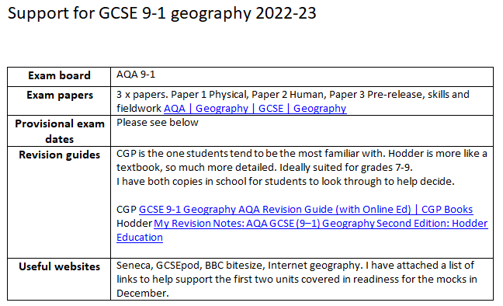
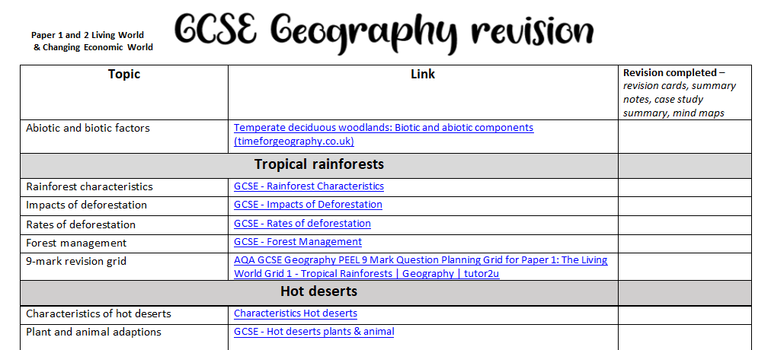
Supporting your child with revision
Information that students and parents will be provided with:
More time will be devoted to revision strategies during form time.
Resources to support understanding the question command words in exam questions.
School has a subscription to GCSEpod, which students can use as part of their revision.
Information sheets for students and parents about the exams.

Slide 42
?

Slide 50
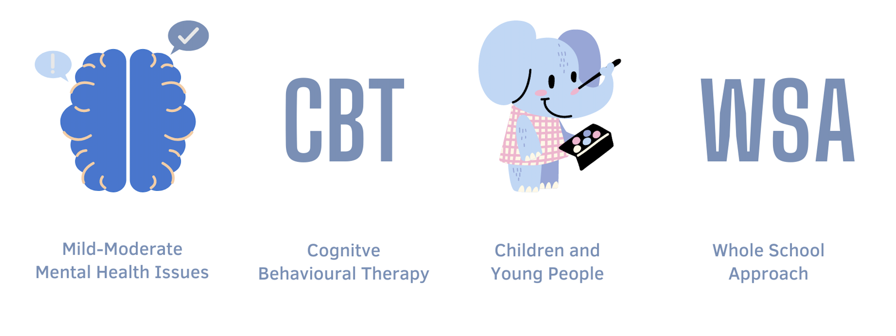
The Bradford and Craven Mental Health Support Team (MHST)
Notes:
ELIZABETH
So, some of you guys may be aware of who we are – but some of you may not. So, we’re going to give you a little oversight as to who we are and what we do. We are the Bradford and Craven Mental Health Support Team, you may know us as an ‘MHST’. These MHSTs were set up as part of the Government Green Paper for ‘Transforming CYPs Mental Health’ and by 2025 they aim to have an MHST in every school in the country.
The MHST work with Mild-Moderate mental health issues and for presenting difficulties for things such as low mood, anxiety, anger, sleep problems, panic, OCD. A large proportion of our workforce are made up of practitioners who practice CBT and they off evidence based interventions to support young people who are presenting with issues such as these.
As well as working with children and young people, we work with the systems around them, including their parents/carers, the communities and all you lot in schools. Working with young people directly is only a fraction of our role as the MHST. Another large part is the Whole School Approach – which is something we’re going to look at in more detail to start with.

Slide 51
Fight, Flight, Freeze
The body’s automatic, built-in ’alarm-system’ designed to protect us from threat or danger
It’s really effective at protecting you from danger – this can be useful at time!
Not so useful when sitting tests/exams
Knowledge is key, understanding this is going on helps!

Slide 52
What can they do?
Plan – revision timetables, check-lists, make it visual, plan in breaks, are there rewards
Pay attention to their self-talk and identify the thoughts that lead to anxiety – you can talk to them about this to help!
Helping with physical tension – mindfulness, breathing, grounding, muscle relaxation, exercise
Make sure they’re still focusing on other things too! – Time with friends and family, interests and hobbies, eating and sleeping!

Slide 53
How can you help?
Rewarding good effort
Put tests into perspective…
Make the time to listen
Normalising feelings
You cannot promise that your child will pass the exam, but what you can do is express confidence that they going to be okay, They will be able to manage it, and that, as they faces their fears, the anxiety level will drop over time.
Notes:
-Rewarding good effort – this could include something related to their interest. This can help increase their self-confidence and motivation.
Put tests into perspective…e.g. we want them do well but it wont make or break their future. They will be loved and valued no matter what the outcome. Tests can provide helpful info as what they are good at and what can get better at.
-Make the time to listen – we feel pressure that it is all on us and we need to provide all the answers, but what is also a powerful tool is listening. Listening to what is coming from children, or equip them to give cues (verbal/ visual) that they can leave out to show they are having a difficult time. It is important to talk to your child about their anxiety or worries as this give you the opportunity to reassure them and show them you understand how they feel. (E.g. feel pressure to do well…I feel that at times too and this is how I manage those feelings).
-Normalising feelings - It can be tempting to dismiss their worries because you want to reassure them, but it’s important to empathise with their experience and validate their feelings, after all we are all in the same boat e.g. feeling anxious about an exam, worry about failing.
You cannot promise that your child will pass the exam, but what you can do is express confidence that they going to be okay, They will be able to manage it, and that, as they faces their fears, the anxiety level will drop over time.

Slide 54
On the exam day…
Plenty of rest the night before
Stick to usual bedtime routines
Good breakfast in the morning
Keep conversation positive, encouraging and light hearted
Leave with words of encouragement
Remind them to breathe deeply before and during the exam.

Slide 55
Top Tips to supporting your young person
Respond with compassion
‘Connection before correction’
Engage in a way that supports problem solving
Be active in their interests
Allow them to learn from their own mistakes
Talking about your own feelings, promoting resilient reflection
Notes:
Respond with compassion
Look for opportunities for connection- ‘Connection before correction’
Engage in a way that supports problem solving
Be active in their interests
Allow them to learn from their own mistakes – accept that they will do things differently to you
Talking about your own feelings, promoting resilient reflection

Slide 56
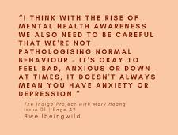
Normal changes vs pathologising
Exams are stressful!
These times can be challenging
The importance is communicating with them - What does your teenage want? - What do you want?
Notes:
Discussion
Has anything changed today in your opinion after hearing the presentation today?
Young people are going through normal 'anxious' times

Slide 57
Signposting Information
Notes:
ELIZABETH

Slide 58
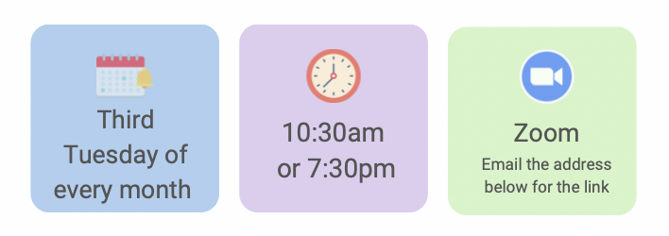
‘Raising Yorkshire Puddings’
Parent Support Group
UPCOMING TOPICS:
Bereavement – 21/03/2023
Making sense of senses
Impact of unhealthy coping strategies
Exam stress
Healthy relationships
Low self-esteem
HOW TO SIGN UP:
mhstparentsupport@bdct.onmicrosoft.com

Slide 59
Thank you,
Please can you complete a feedback form
Have a safe journey home

