Slide 1
Summer Exams 2023

Slide 2
In the run up to and during exams…..
Equipment
Sleep
Diet/Hydration
Environment
Physical wellbeing
Relaxation
Breaks

Slide 3
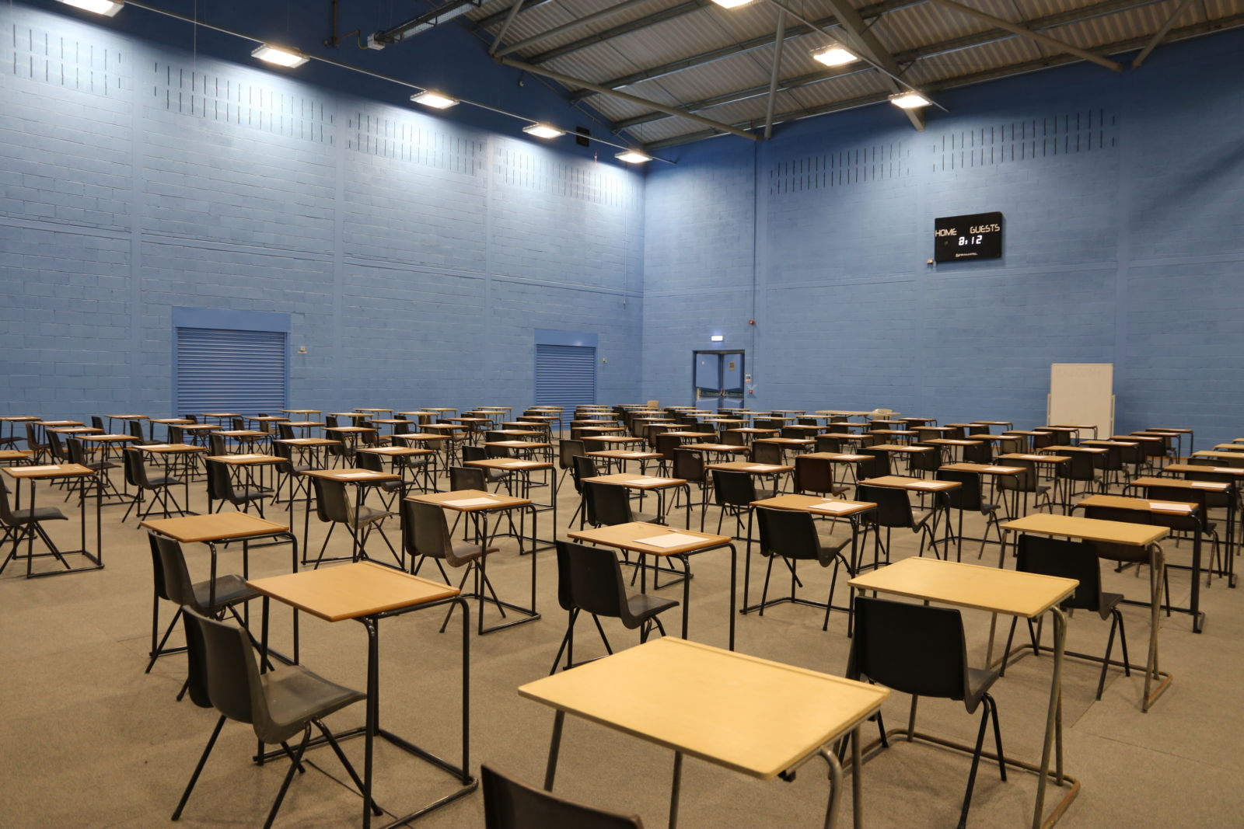
Exam dates
The summer 2023 exam series runs from Monday 15th May 2023 to Tuesday 20th June 2023, please also note the contingency date below.
Exams will start at 9am in the morning or 1pm in the afternoon.
We remind candidates sitting exams this summer that they will need to make sure that they are available until the contingency date of Wednesday 28th June 2023 .

Slide 4
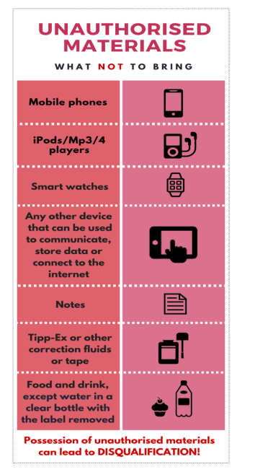
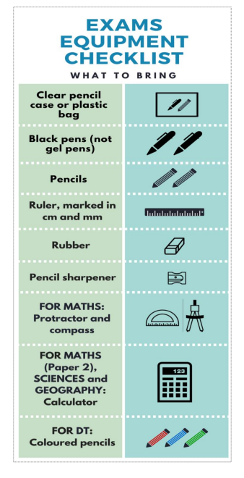
Equipment
What’s in my bag?

Slide 13
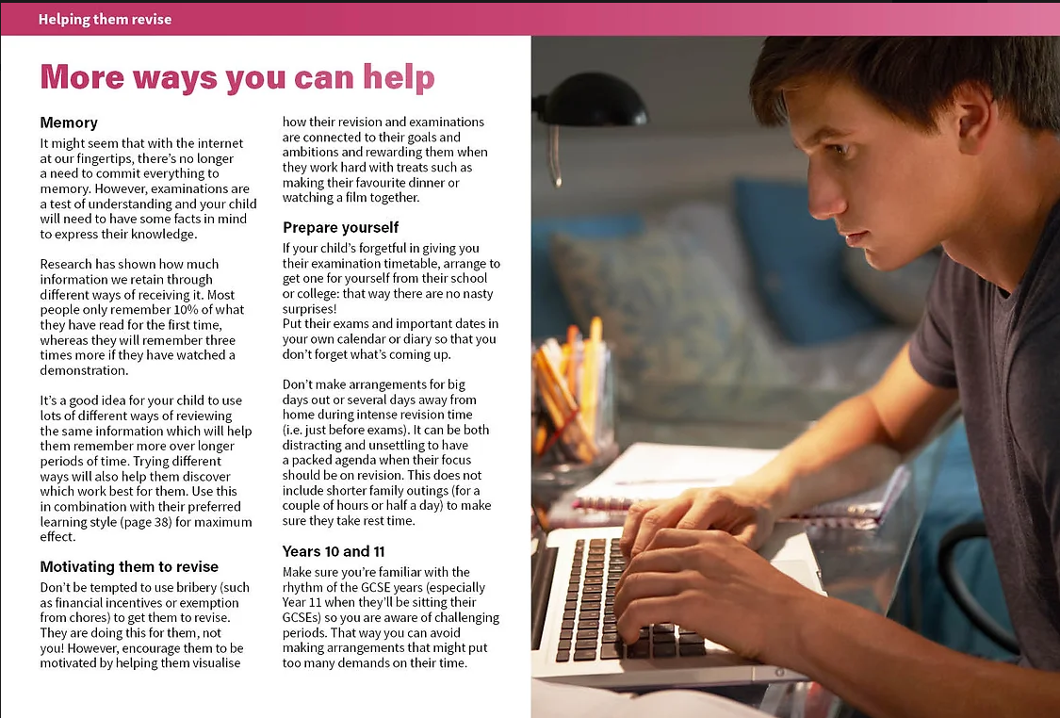

Slide 17
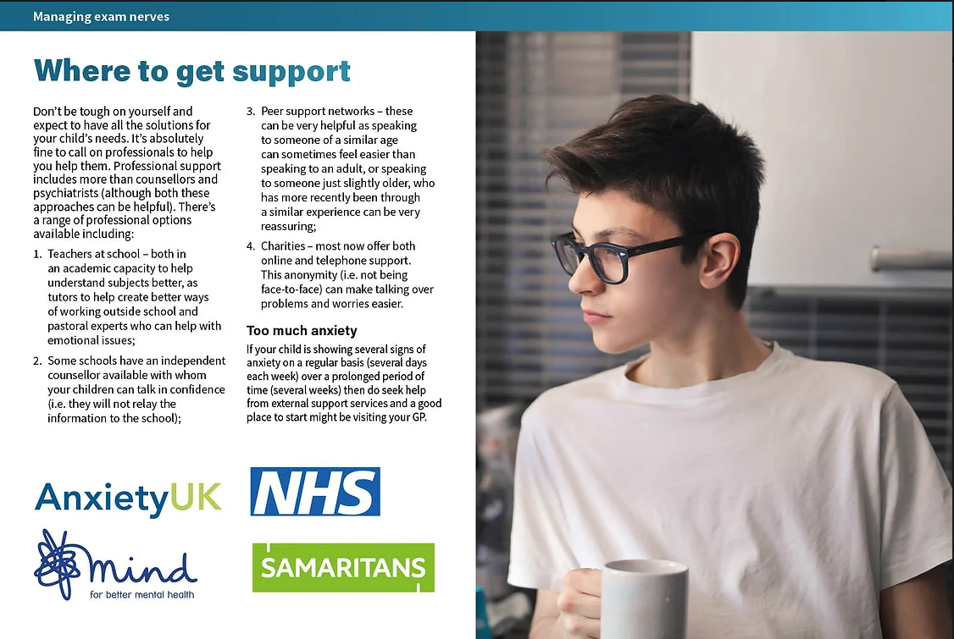

Slide 18
What if I am ill on the day of the exam?
Special consideration is given to a candidate who has temporarily experienced illness, injury or some other event outside of their control at the time of the assessment. It is applied when the issue or event has had, or is reasonably likely to have had, a material effect on a candidate’s ability to take an assessment or demonstrate his or her normal level of attainment in an assessment.
Often 3% applied to an event e.g. death to a close relative or 2% for illness at the time of the examination

Slide 19
Results Day 2023
Thursday 24th August from 10 am
Sign up to 6th form
Appeal?
Access to scripts - You can request a priority copy of the marked exam paper to help you to decide whether to request a review of marking or a clerical re-check
Review of marking - If you request a review of marking, your grade(s) may be lowered, confirmed or raised following the review. We will ask you for written consent before we request this service on your behalf.

