Slide 1
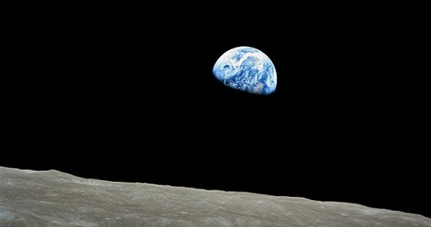
Notes
Use your textbook – catch-up and add to your notes
Try Cornell notes (https://tinyurl.com/y462dzcr)
Physics & Maths tutor (https://tinyurl.com/ykj84xep)
A level Physics online (https://tinyurl.com/37d9pnrk)
Practise, practise, practise
AQA website for past papers (https://tinyurl.com/44snvuau)
Physics & Maths tutor (https://tinyurl.com/j2uackt4)
IsaacPhysics
A LEVEL PHYSICS INDEPENDENT STUDY
Check what’s in the course: https://tinyurl.com/4c3hpncp
Plus use the topic checklists
Listen
Life Scientific (https://tinyurl.com/2xf5r8ax)
Infinite Monkey Cage (https://tinyurl.com/2ytkyj8f)
Reading
Look at the reading list in your Physics handbook
Ask your teacher for Physics World

