Slide 1
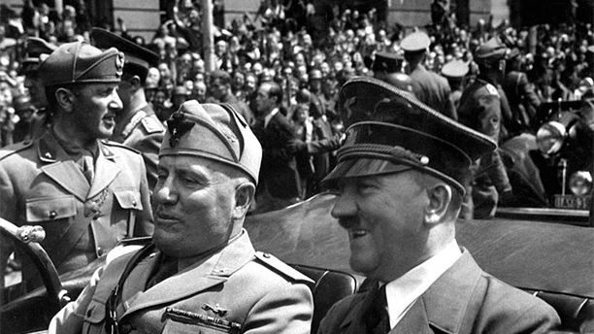
Notes
Use your textbook – catch-up and add to your notes
At the end of a topic, produce a mind map summary of the key points.
Set quiz questions on a topic to test your understanding, see how many you can answer the next week, the next month.
Specification
https://qualifications.pearson.com/en/qualifications/edexcel-a-levels/history-2015.html
Past papers/markschemes
https://qualifications.pearson.com/en/qualifications/edexcel-a-levels/history-2015.coursematerials.html#%2FfilterQuery=category:Pearson-UK:Category%2FExam-materials
HISTORY A LEVEL INDEPENDENT STUDY GUIDE
Extend your knowledge
Read something from the extra reading list/shelves in B1 or B4
Read Modern History Review magazine
Listen to a podcast
https://www.bbc.co.uk/sounds/brand/p07mdbhg
Revision resources
Hodder My Revision Notes for each of the examined Units
Khan Academy YouTube clips

