Slide 1
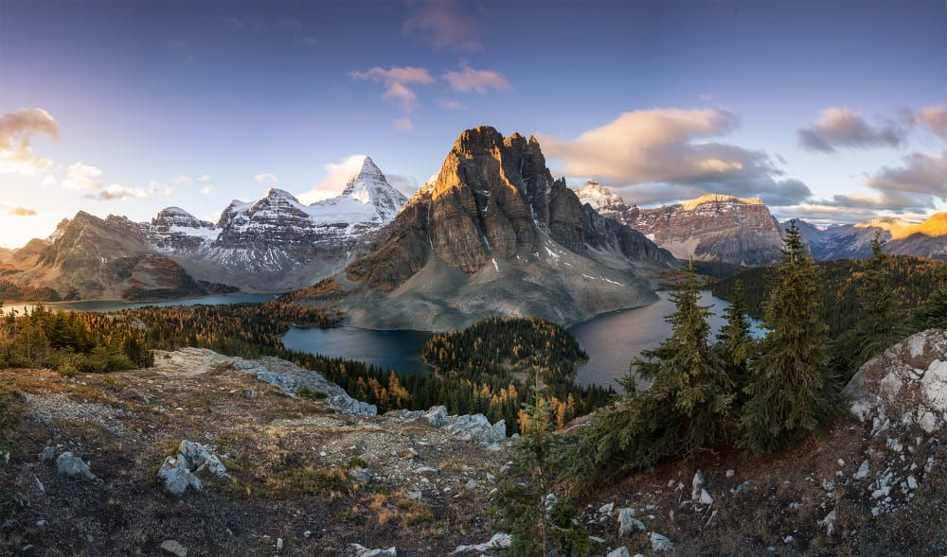
Notes
Use your textbook – catch-up and add to your notes
At the end of a topic, produce a mind map summary of the key points.
Set quiz questions on a topic to test your understanding, see how many you can answer the next week, the next month.
Specification
Link here
Past papers/mark schemes/examiners reports
Link here
What you need to know for coasts
GEOGRAPHY A LEVEL INDEPENDENT STUDY GUIDE
Revision resources
Hazards
Superpowers
Regenerating Places
Coasts
Carbon and Water
HHRI
Globalisation
Extend your knowledge
Beyond the spec: A-Level Geography — Kate Stockings
No such thing as a natural disaster

